Slide 1
ABBA -Abandoned Book Box Application
A n d r o i d A p p l i c a t i o n
version android alpha 0.0.1

Slide 2
Search steps
ABBA
INTRODUCTION
SYSTEM ANALYSIS
DESIGN CONSIDERATION
IMPLEMENTATION AND VALIDATION
SYSTEM DESIGN

Slide 3
INTRODUCTION
Project Scope | Motivations | Existing Systems

Slide 4
Project Scope
Help people make use of their old course books and materials.
Help people save their money and others.
Reducing the phenomenon of throwing and neglecting books and benefiting from them in a longer time.

Slide 5
Motivations
Books, handbooks, and exercise papers are essential to the university student, but if the student finishes the course, He won't need it anymore and maybe throwing it in the trash, burning it or forgetting it next to the discarded items Until it becomes obsolete and has no value after publishing newer versions, And do not forget that some students cannot buy some of the most expensive books. The proposed project will solve the problems mentioned above by developing the App for Abandoned Books.

Slide 6
Existing Systems
To search for used books you need relationships with some students or request a book in WhatsApp groups. There are some charities for all used books, but there are no students who put or search for used university books in them. There are some applications on Play Store, but they are in English language or general applications in books (novels, stories, etc.) and do not contain study books.

Slide 7
Limitations of the existing systems
• General for all books and there is no section for undergraduates.
• The storage system for books in charitable societies has limitations and difficulty in searching because some of them are limited to display on shelves only.
• Just giving away books for free.

Slide 8
SYSTEM ANALYSIS
System Requirement | Data Analysis

Slide 9
Functional Requirement
• Create a new book (offer) by entering (book details, book price, book category).
• Save the new book (offer) data in the database.
• Support for Arabic users.

Slide 10
Non-Functional Requirements
• Performance: run app within maximum 2.5s.
• Ease of use: The ease of our system is that we target university students.
• Cost-effective: Our app will be free to use so that maximum number of students can get benefit from it.
• Maintenance: It will be easy to do maintenance without complex work, and fixing error will be easy and it's passable to add new features from the admin panel.

Slide 11
SYSTEM ANALYSIS
System Requirement | Data Analysis

Slide 12
Data Analysis
Context Diagram | Data Flow Diagram for Admin|
Data Flow Diagram for User|
Entity Relationship Diagram

Slide 13
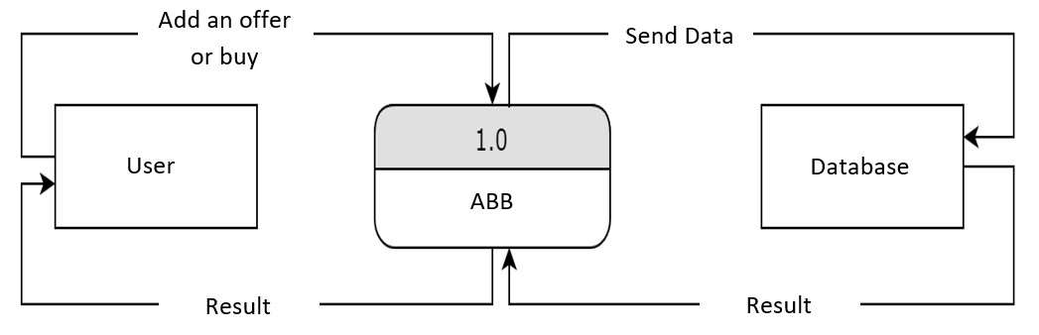
Context Diagram

Slide 14
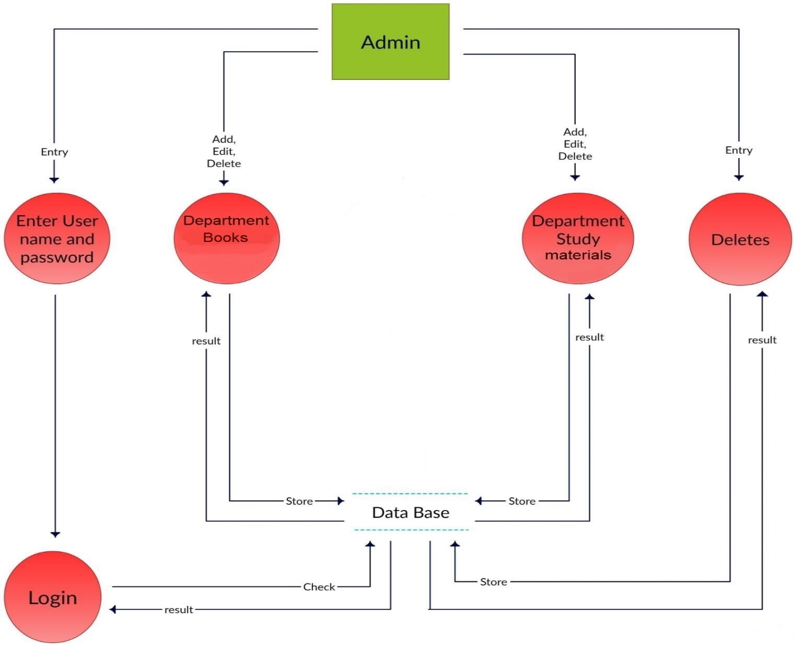
Data Flow Diagram for Admin

Slide 15
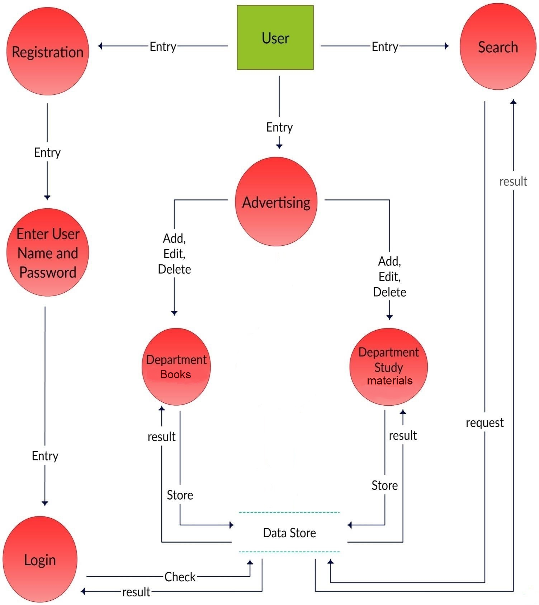
Data Flow Diagram for User

Slide 16
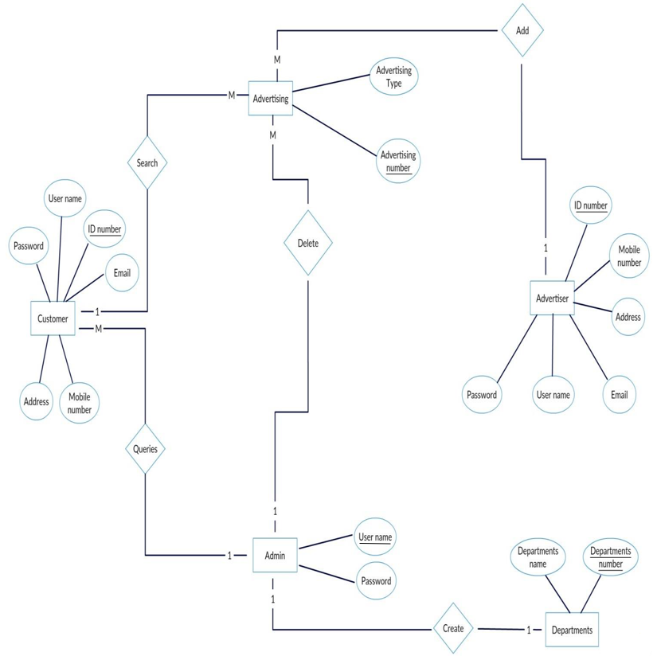
Entity Relationship Diagram

Slide 17
INTERFACES
Login| University books department

Slide 18
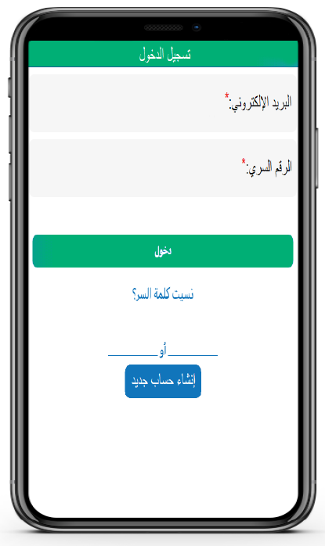
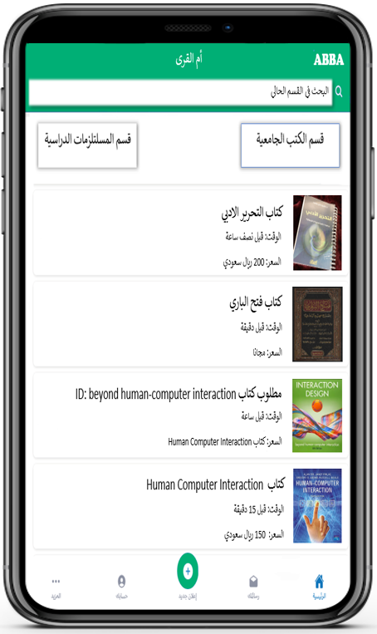
Login| University books department

Slide 19
DESIGN CONSIDERATION
Hardware Requirement | Software Requirement | Algorithm To Be Used

Slide 20
Hardware Requirement
Android Phone: The Android version is preferred 4.1.1 and higher because it does not need any specific hardware or any high requirements, supports all devices android system.
Computer: The system uses a normal computer with at least 8GB memory.
Camera (or not): The system uses a normal camera that comes with an android device.

Slide 21
Software Requirement
Operating system | Android Studio | Firebase control panel
Windows OS: We will be using windows OS because it’s easy to use and it does not require very high configuration machine and its machine independent not like MAC OS.
Android studio: We will be using android studio because it’s the most common IDE to develop android application and we have some good experience in it.
Firebase control panel: We will be using Firebase control panel for database, creating and management.

Slide 22
SYSTEM DESIGN
System Architecture | Process Diagram | Use Case Diagram| Class Diagram

Slide 23
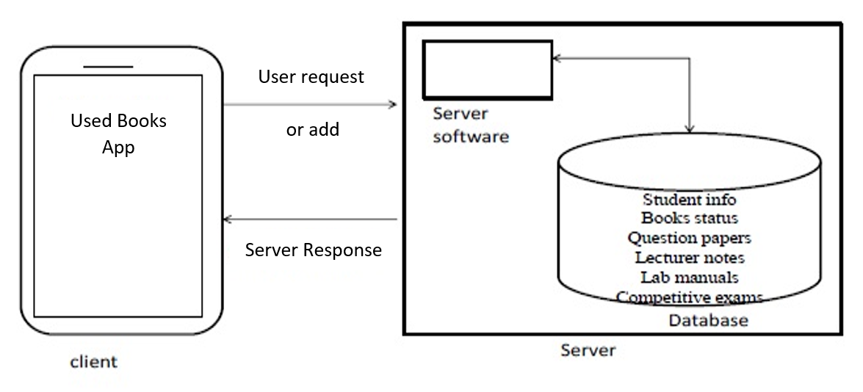
System Architecture

Slide 24
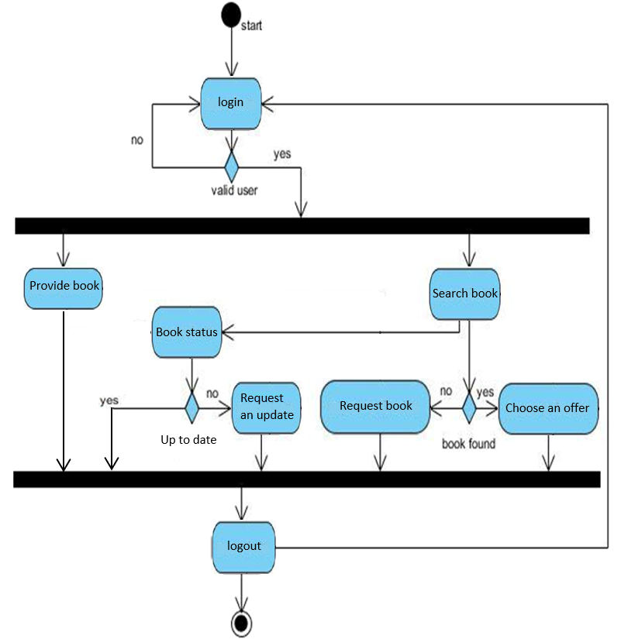
Process Diagram

Slide 25
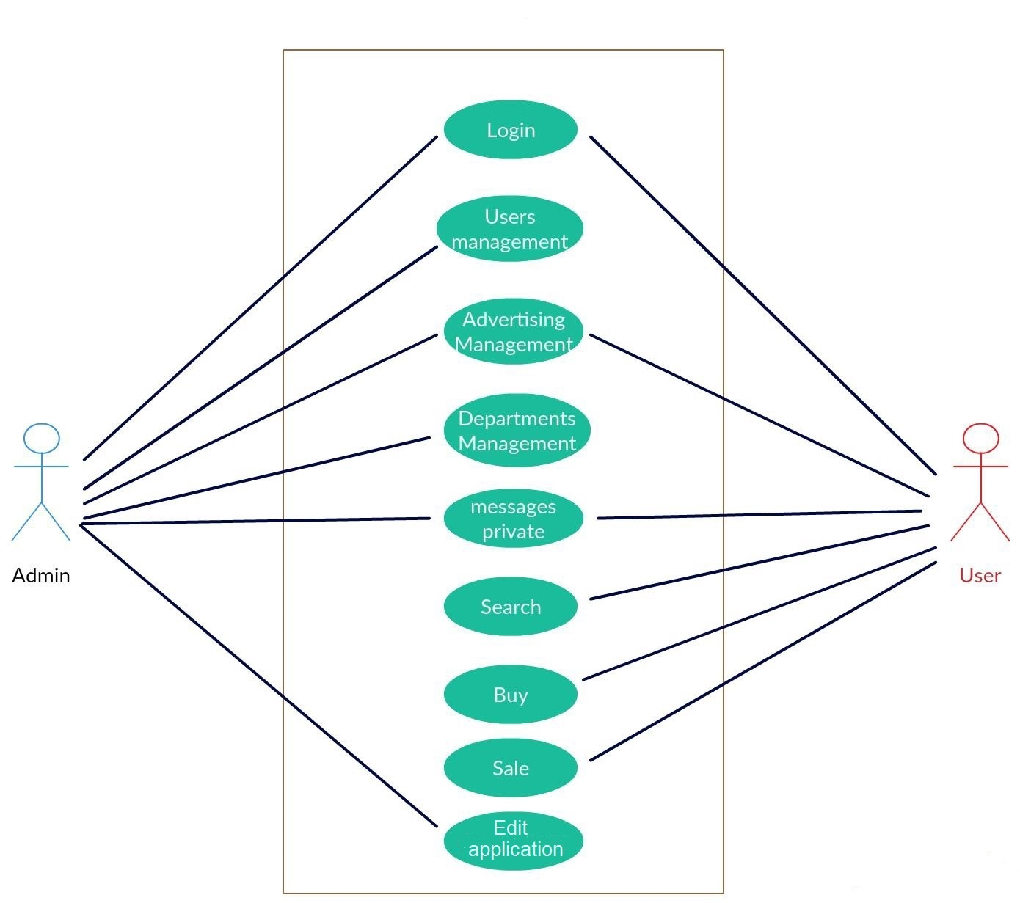
Use Case Diagram

Slide 26
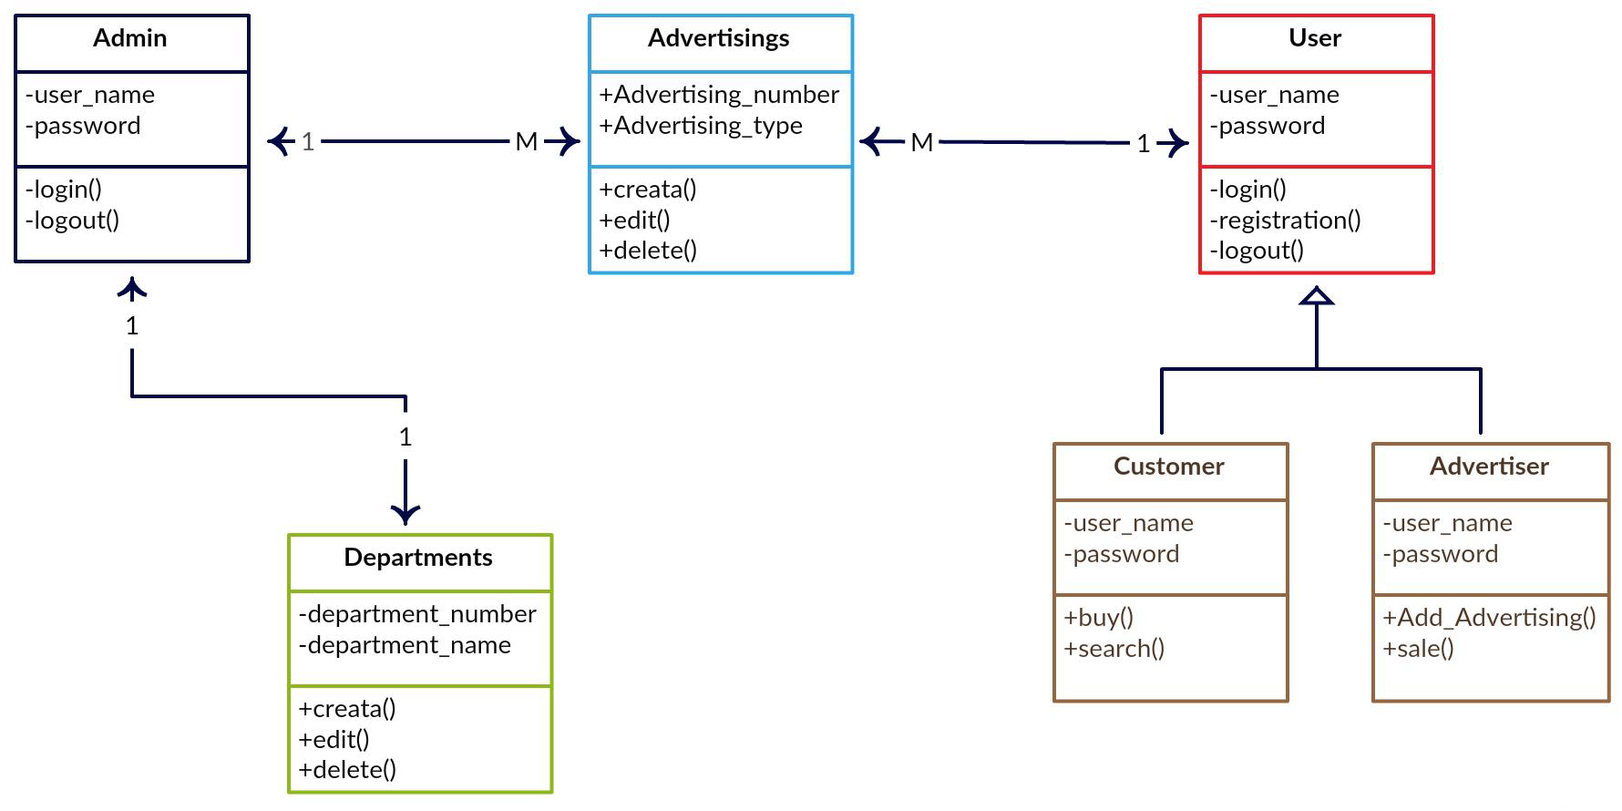
Class Diagram

Slide 27
IMPLEMENTATION AND VALIDATION
Login as Customer / Seller | Forget the password | Create new account for customer | Create new account for Seller | Customer side | Seller side

Slide 28
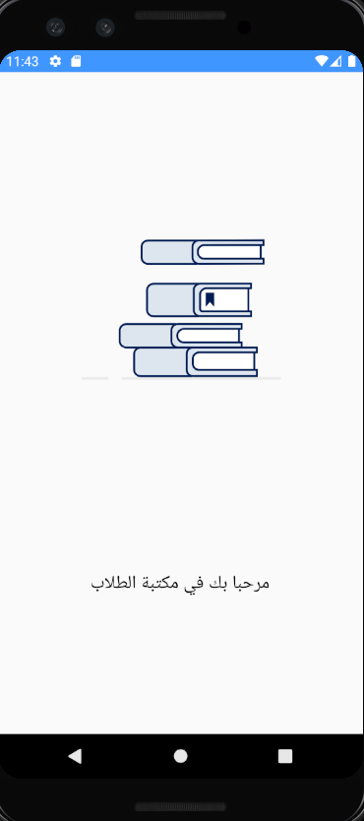
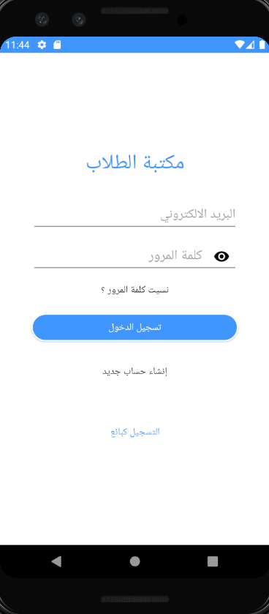
Login as Customer / Seller

Slide 29
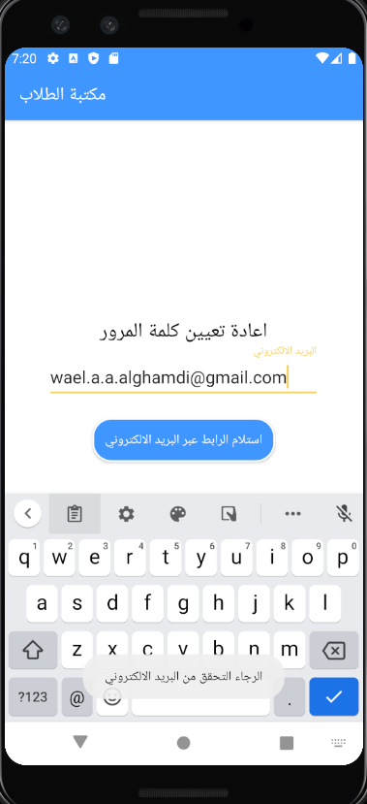
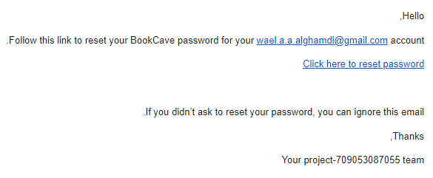
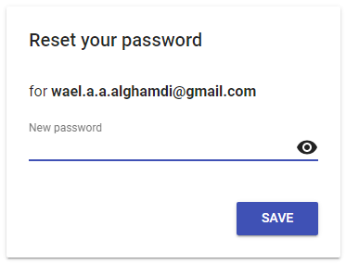
Forget the password

Slide 30
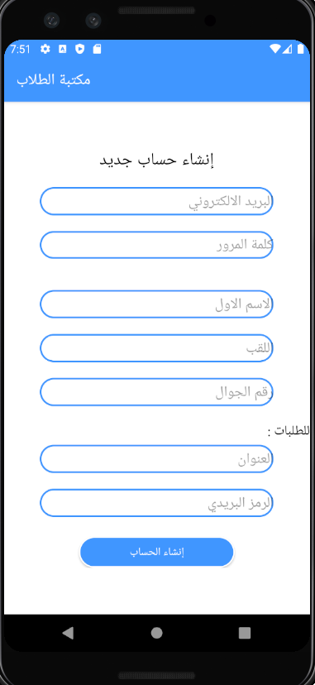
Create new account for customer

Slide 31
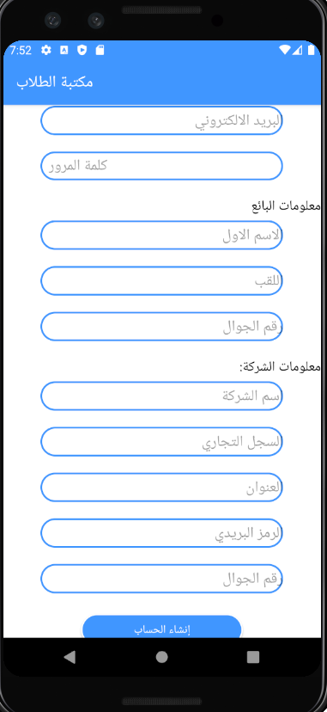
Create new account for Seller

Slide 32
Create new account for Seller

Slide 33
Customer side
Customer home page | Preview the available book | Buy/Rent/Get for free an available book | Search for a book | Customer profile | Customer profile details | Customer order history | Customer payment history | Communicate with developers | About the application

Slide 34
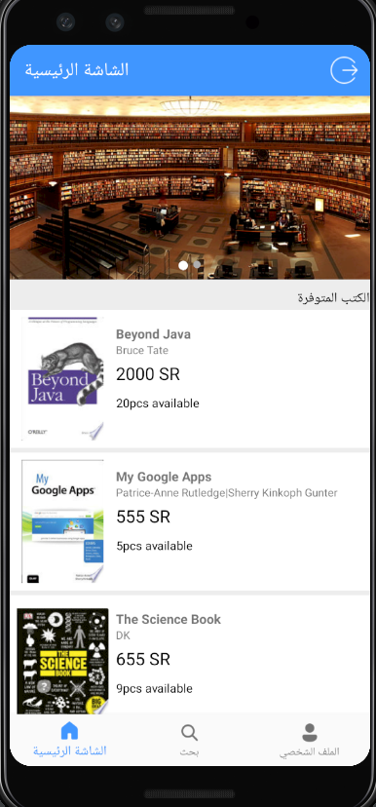
Customer home page

Slide 35
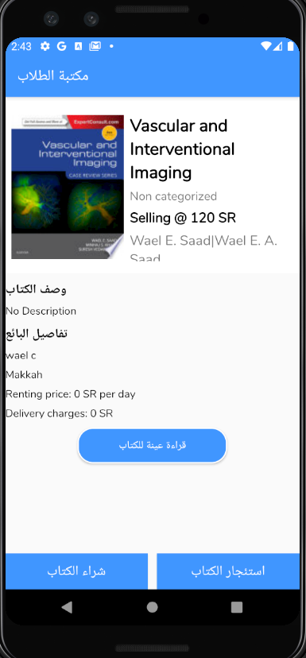
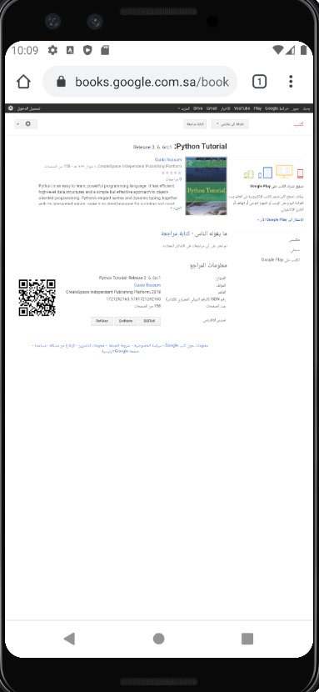
Preview the available book

Slide 36
Preview the available book

Slide 37
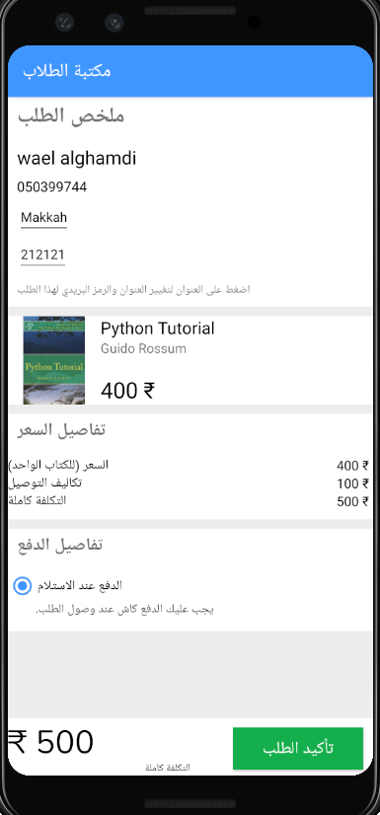

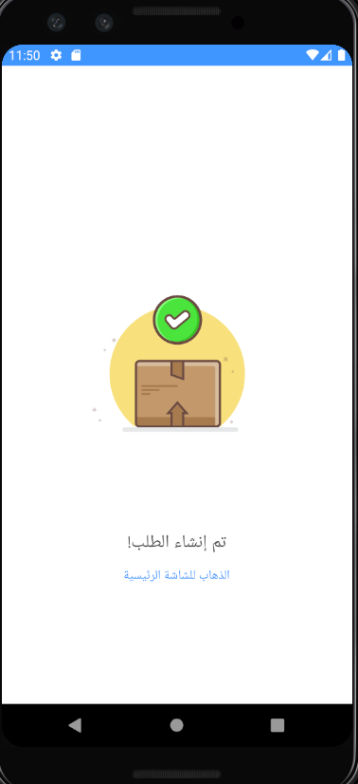
Buy/Rent/Get for free an available book | Search for a book

Slide 38
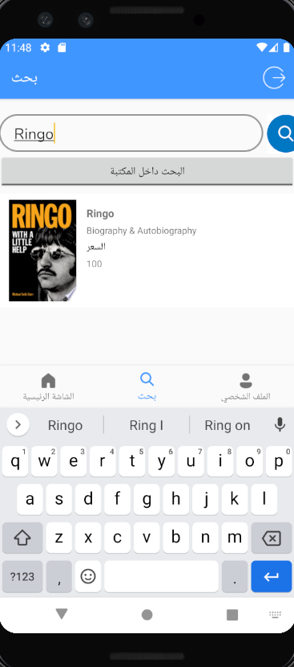
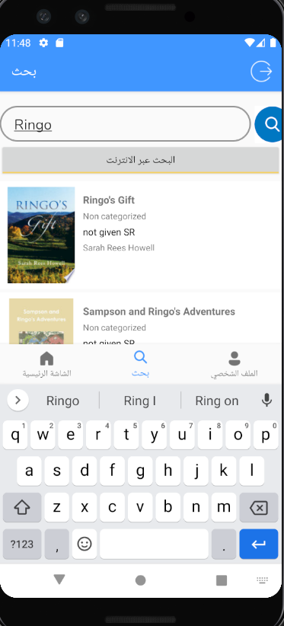
Search for a book

Slide 39
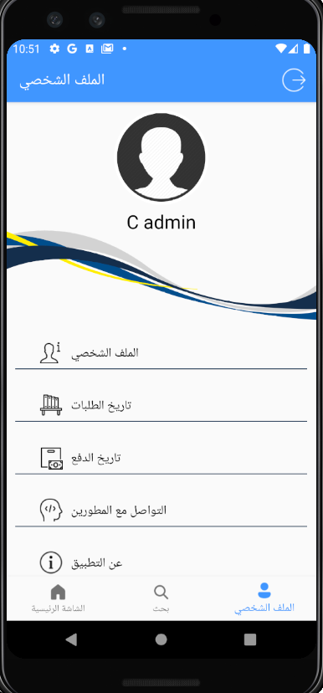
Customer profile

Slide 40
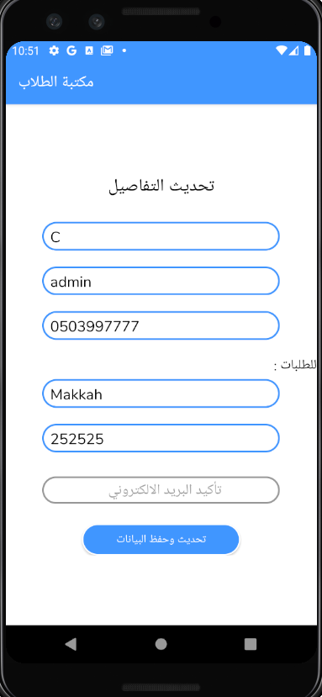
Customer profile details

Slide 41
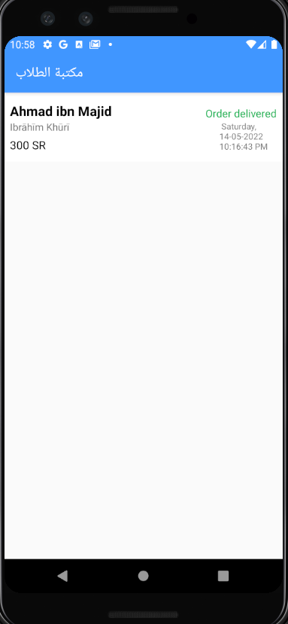
Customer order history

Slide 42
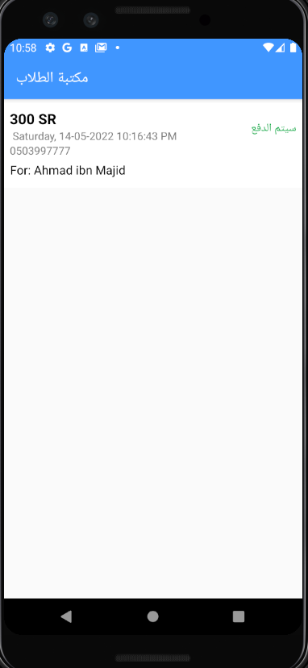
Customer payment history

Slide 43
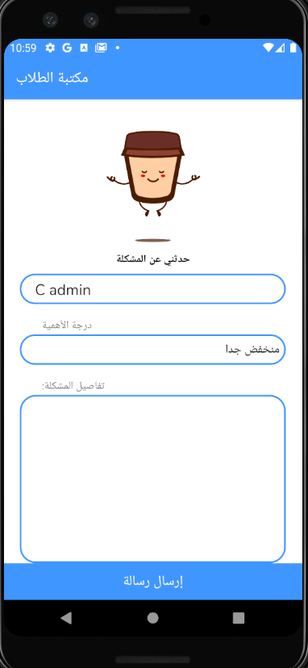
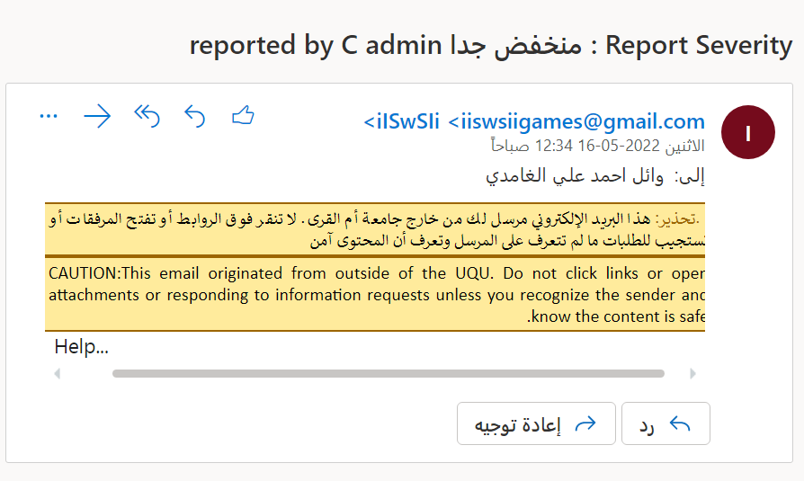
Communicate with developers

Slide 44
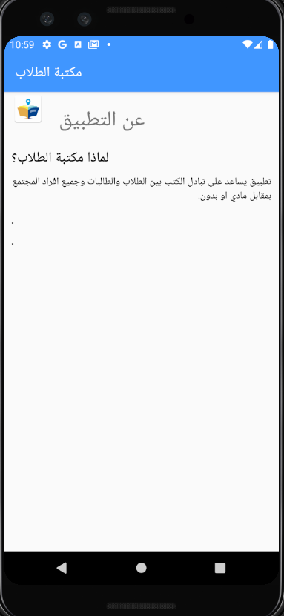
About the application

Slide 45
Seller side
Seller home page | Inserting a book into the app | Books added by seller | Seller profile details | Buyer details and expected payment date | Communicate with developers | About the application

Slide 46
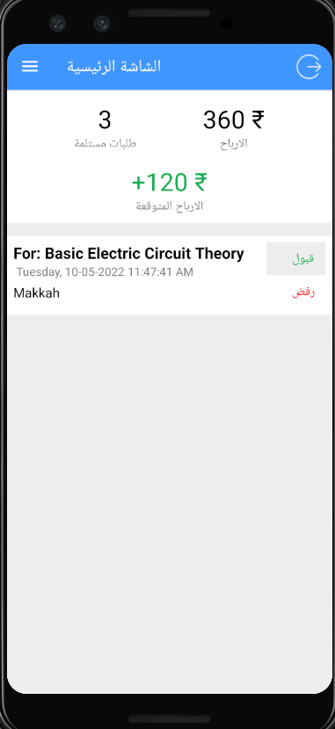
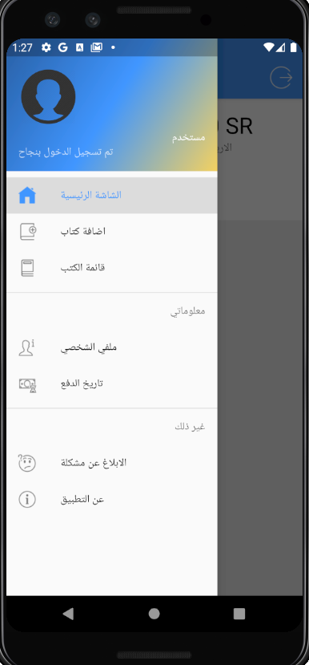
Seller home page

Slide 47
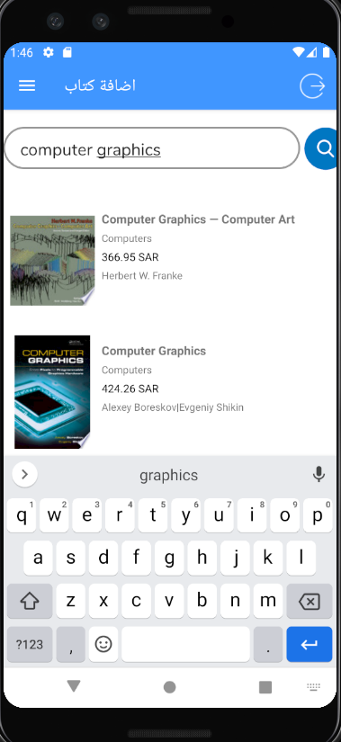
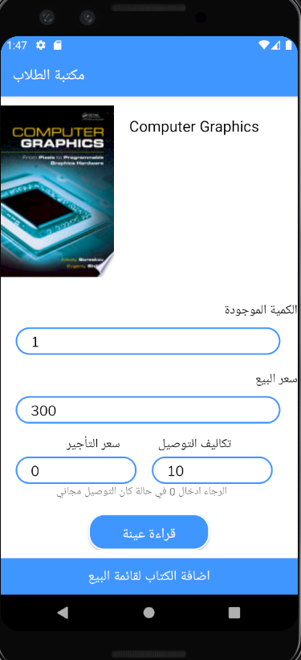
Inserting a book into the app

Slide 48
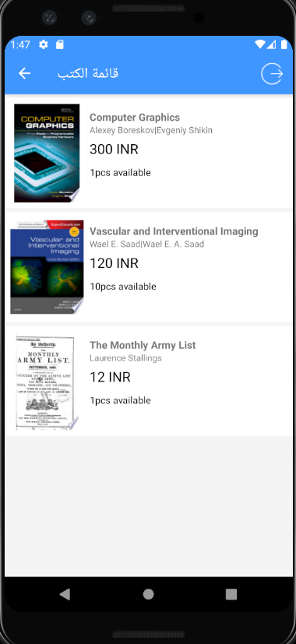
Books added by seller

Slide 49
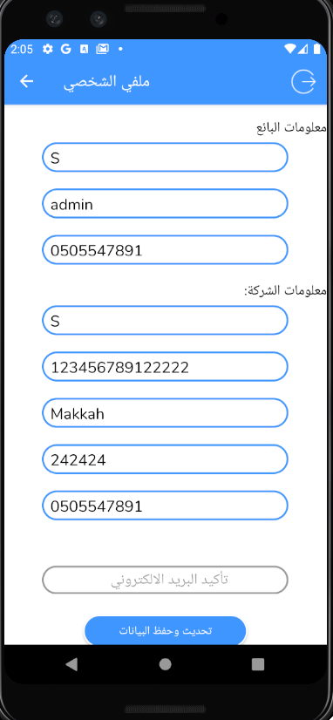
Seller profile details

Slide 50
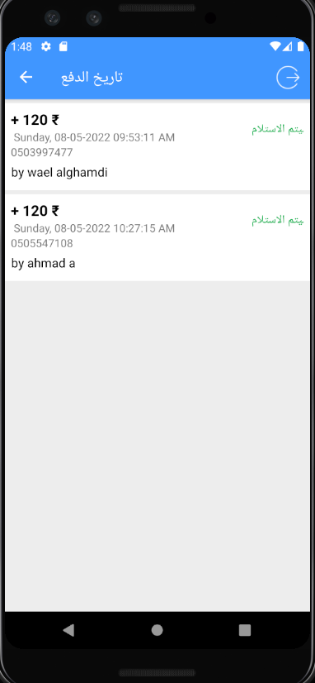
Buyer details and expected payment date

Slide 51
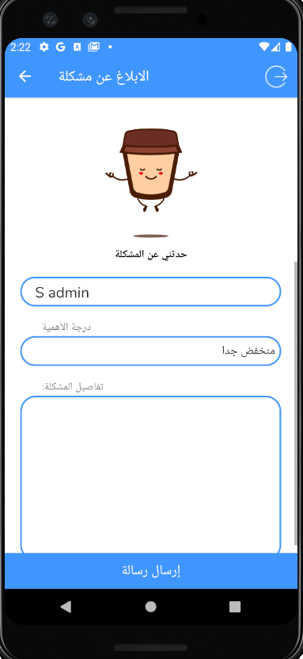
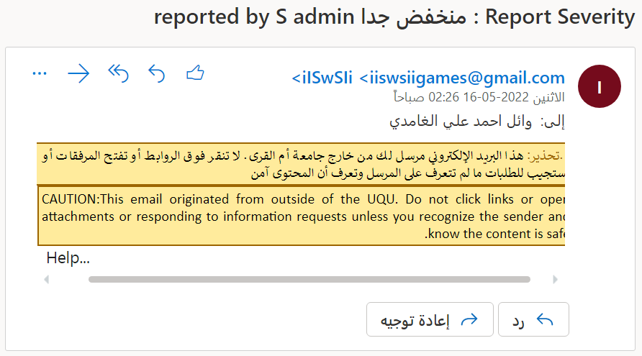
Communicate with developers

Slide 52
About the application

Slide 53
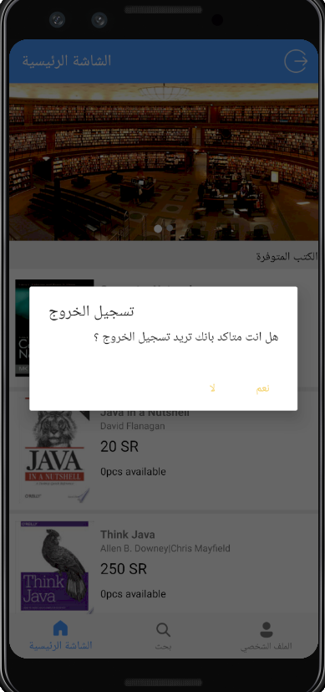
Logout

Slide 54
Future Enhancements
• The ability to pay using MADA, Visa, PayPal.
• Develop the app in IOS not only android.
• Add more products besides university books and study materials.

Slide 55
Thank you for listening

Slide 56
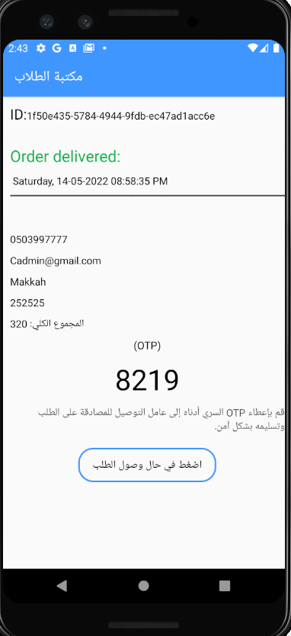
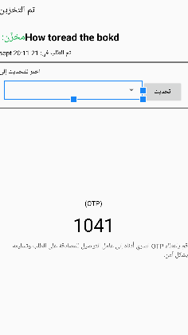
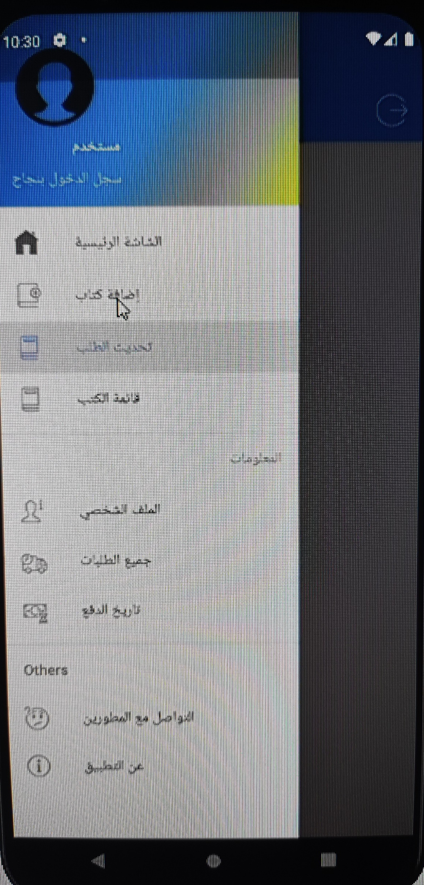
Logout

